Slide 1
Does Titling Matter? Evidence from Housing Markets in India
Bento, Lall and Landry (2013)
February 9, 2016

Slide 2
Introduction
924 million people of the world’s population (31.6%) live in slums (UN, 2003)
Slum life characteristics:
Informal home ownership and squatting
Concentrated poverty
Inadequate access to housing basic public services, formal credit, and job markets
Characteristics have disproportionate impacts on slum dwellers, which can exacerbate their social exclusion
Policies aimed to improve slum dweller welfare
Slum upgrading
Expansion of municipal services and infrastructure to slum communities
Legal titling for slum dwellers

Slide 3
Research Question
Is titling an effective a strategy for improving the welfare of the urban poor in Pune, India?
Bento et al. aim to answer this question by estimating whether titling has been capitalized into housing values.
Literature Review:
Mixed evidence regarding whether provision of formal property rights improves the welfare of the poor.

Slide 4
Data Source
Survey data on households in Pune squatter settlements from World Bank’s Pune Household Survey from August to October of 2002
Focus on squatter households in Pune, India, the second largest city in the Maharashtra state
Per capita income level that is 50% higher than national average and one of the lowest levels of income disparity in India.
Experienced rapid growth in its industrial education and information technology sectors
Rapid population growth of 24% over last 5 years.
Proportion of slums in Pune (35.7%) is slightly larger than world average of 31.6%

Slide 5

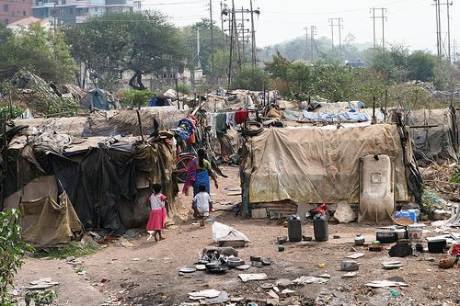
Slum Settlements in Pune

Slide 6
Methodology
Bento et. al use both an OLS method and a propensity score matching (PSM) method to estimate impact of titling
OLS is likely to be an overestimate relative to PSM estimate
PSM: matching methods make no functional form assumption and permit comparisons only between observations that share a common support
Matches control housing units that received slum upgrading and improved access to municipal services like treatment housing units
Hypothesis: Impact of titling likely differs among observable characteristics because slum upgrading and improvements in municipal services access is likely to improve tenure security

Slide 7
Methodology
Quasi experimental research design:
notified squatters= untreated group
Resettlements= treated group
Resettlement is involuntary, assignment of treatment is independent of household and neighborhood characteristics.
No pre-treatment data on both groups
Owner occupied, have been living in current location for 10 years or longer
Excludes non-notified squatters and renters because too few observations exist for analysis

Slide 8
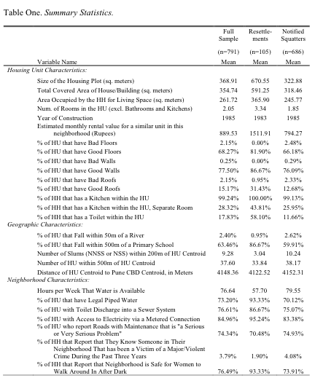
Summary Statistics

Slide 9
Summary Statistics Cont.

Slide 10
Summary Statistics: Highlights
Resettlements have an additional 1.5 rooms and an additional 120.1 square meters of living space over squatters
Resettlement housing units more likely to have good walls, floor and roof, and a kitchen in a separate room and a toilet in the house
Resettlements slightly less densely concentrated than notified squatters, better access to primary schools than notified squatters.
Resettlements may be located in higher elevations than squatters, resulting in resettlements having less available water in hours per week than squatters.

Slide 11
OLS Estimation
Semi- log model specification:
Y_{iw}= natural log of estimated monthly rental value of housing unit
Household’s marginal willingness to pay for vector of dwelling unit and neighborhood characteristics included on the right hand side
Title_{iw}= dummy equal to 1 if housing unit possesses a title
X_{iw} = vector of covariates- housing unit, geographic and neigborhood
δ_{w}= unobservable, house invariant fixed effect from residing in given administrative ward

Slide 12
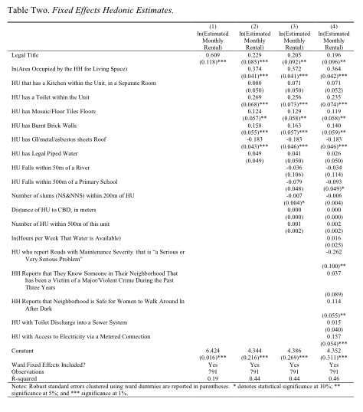
OLS Model: Results

Slide 13
OLS Model: Results, cont.

Slide 14

Propensity Score Matching Model
Δ_{TT}= Average willingness to pay for a title for those households that actually received a title
Y₁= potential outcome from housing unit possessing a title
Y₀= potential outcome for a housing unit without a title
D=1, indicates a household that received a title, D=0 indicates a household that did not
X= vector of observed covariates
Step 1= Semi-parametric probit model to estimate binary variable for participation given X.
Probit includes all of covariates included in column 4 of OLS specification

Slide 15
Propensity Score Matching Model: Relationship Between Titling and Common Support
Issue: Common Support Bias
PSM solves this by comparing resettlements that have received slum upgrading and improved access to municipal services and infrastructure with notified squatters that have received those improvements as well (and vice versa)
Important – effects of titling may vary with amount of tenure security a household possesses, which is correlated with observable characteristics as measured through the propensity score.
Impacts of titling likely non-linear, with respect to propensity score.
Issue: Potential for bias from unobservables may be correlated with propensity score.
Conventional hedonic methods may overestimate effects of titling
Ex. Less likely that resettlements that received slum upgrading and/or improved access to municipal services and infrastructure were relocated to redlined neighborhoods (credit market exclusion)
Matching helps to eliminate bias from selection on unobservables

Slide 16
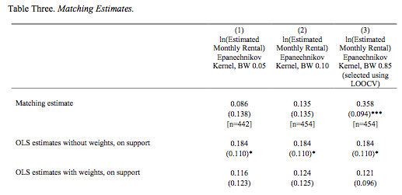
Propensity Score Matching Estimates
3 bandwidths (0.85, 0.10, 0.05). 0.05 chosen because smoothing bias is the smallest and still passes balancing test.
* Statistical significance at 10%
** Statistical significance at 5%
*** Statistical significance at 1%

Slide 17
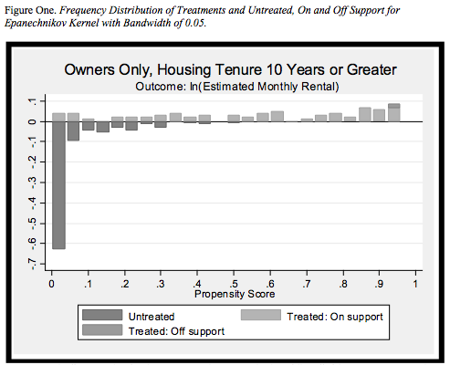
Propensity Score Matching Model: Results
Top Histogram: Dwellings that received a title
Bottom Histogram: Dwelling units that did not receive a title

Slide 18
Propensity Score Matching Model: Results
63% of untreated group lies below 5th percentile of treated group
Mean propensity score
Treated= 0.42
Control = 0.14
Support condition holds very weakly, matching estimates end up having high variances.
When variance at lowest under 0.85 model, which best fits observations on common support, impact of titling remains small and insignificant.
Titling likely to have a smaller impact for slum dwellers with housing upgrades than those without because they already enjoy greater tenure security as a result of receiving slum upgrading and improved access to municipal services
Estimate of the impact of titling under PSM is substantially lower than under the conventional OLS hedonic.

Slide 19
Findings
Central finding: No statistically significant effect of titling on property values
Using OLS- statistically significant effect of titling on housing values of 19.65% of estimated monthly rental value of housing unit
Same as what has been found in the literature
Using PSM- effect of titling of only 8.6%, which is not statistically significant
Titling, when paired with additional interventions to improve the welfare of the poor (like slum upgrading and improvements in access to municipal services), has no additional impact on property values
Slum upgrading and improvements in access to municipal services already enhance informal rights to a degree that formalizing those rights with a title has little to no additional impact on property values.
Slum dwellers in Pune have limited access to credit markets and possess strong informal tenure rights, provision of formal title has little additional impact on welfare capitalized into property values.
May be more important in this case to target tenure security directly

Slide 20
Limitations
Paper explains very little regarding the policy implications of Pune, and whether or not their finding would be scalable.
Resettlements made up a much smaller portion of the population studied as compared to slum dwelling households which impacts even the propensity score model.
Pigeon-holed to this specific community in Pune where informal support for slum settlers is very strong.
Would these results be applicable to regions where slum settlers have very little support? Would titling have the same small impact or would it be larger? What about high credit access?

